Slide 1
Celebes Stress Inversion

Slide 2
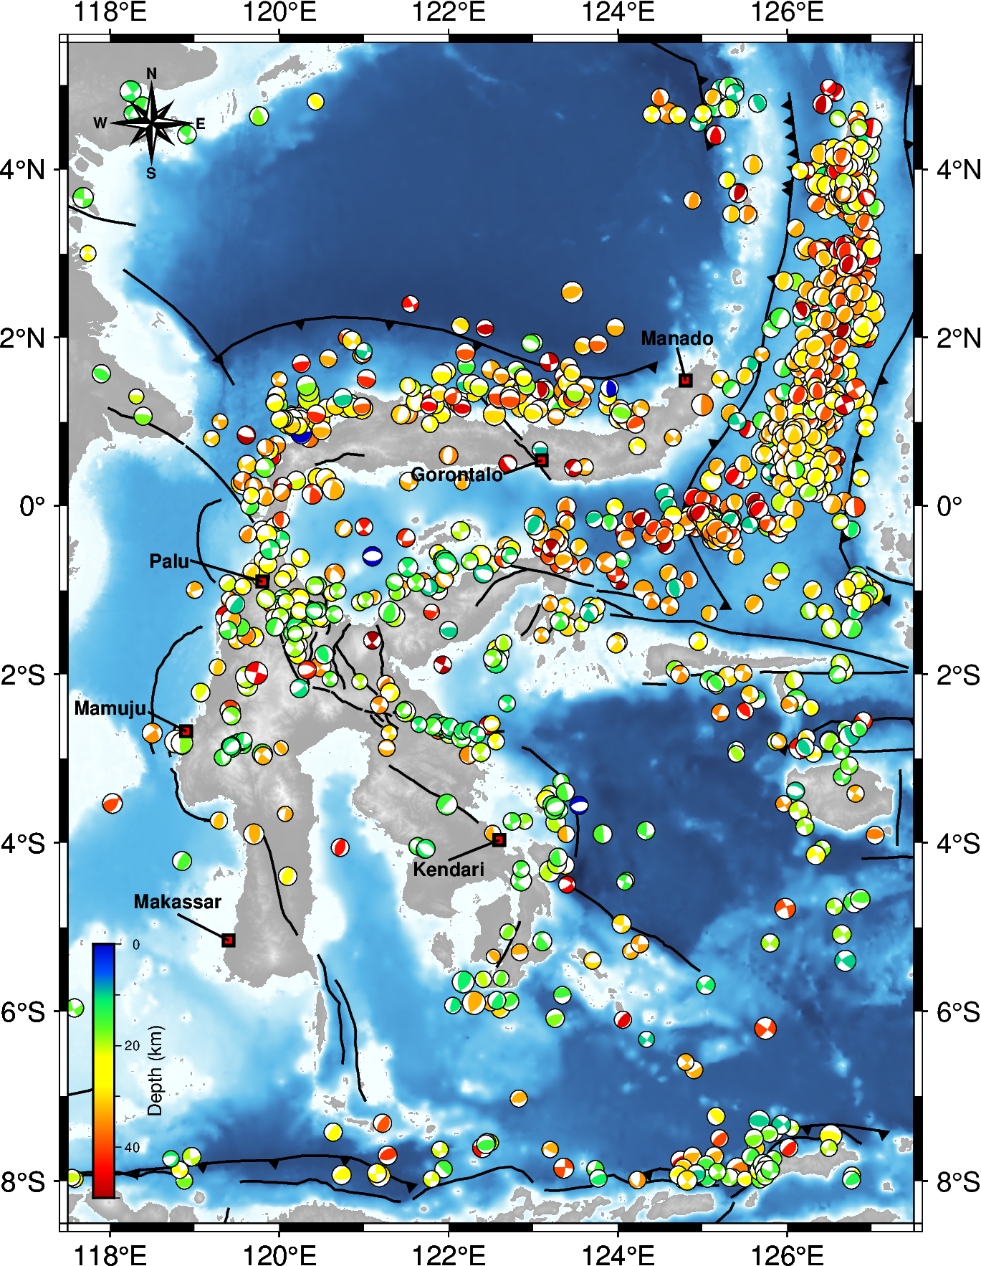
Focal Mechanism Data
1390 focal mechanisms from 1967 until 2022 with maximum depth < 50km and 4.0 < Mw < 7.0.

Slide 3
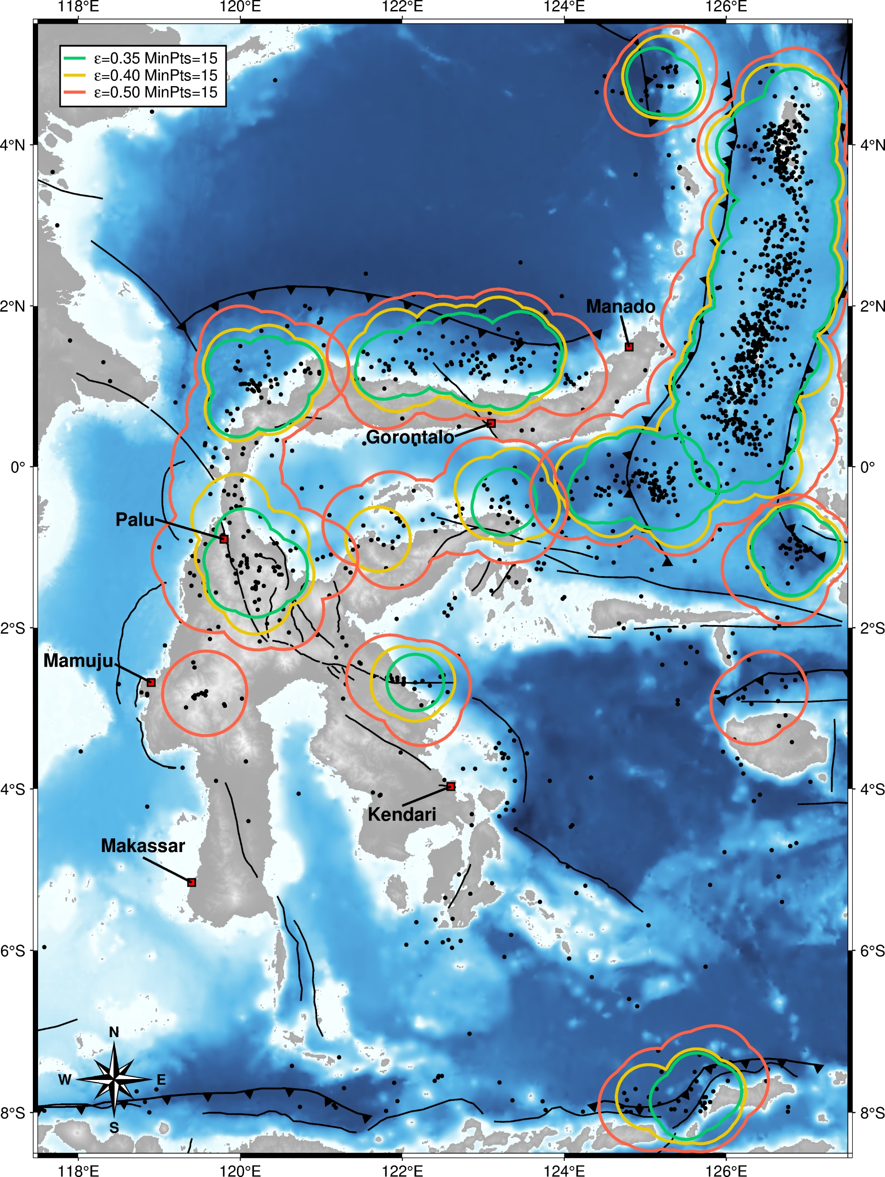
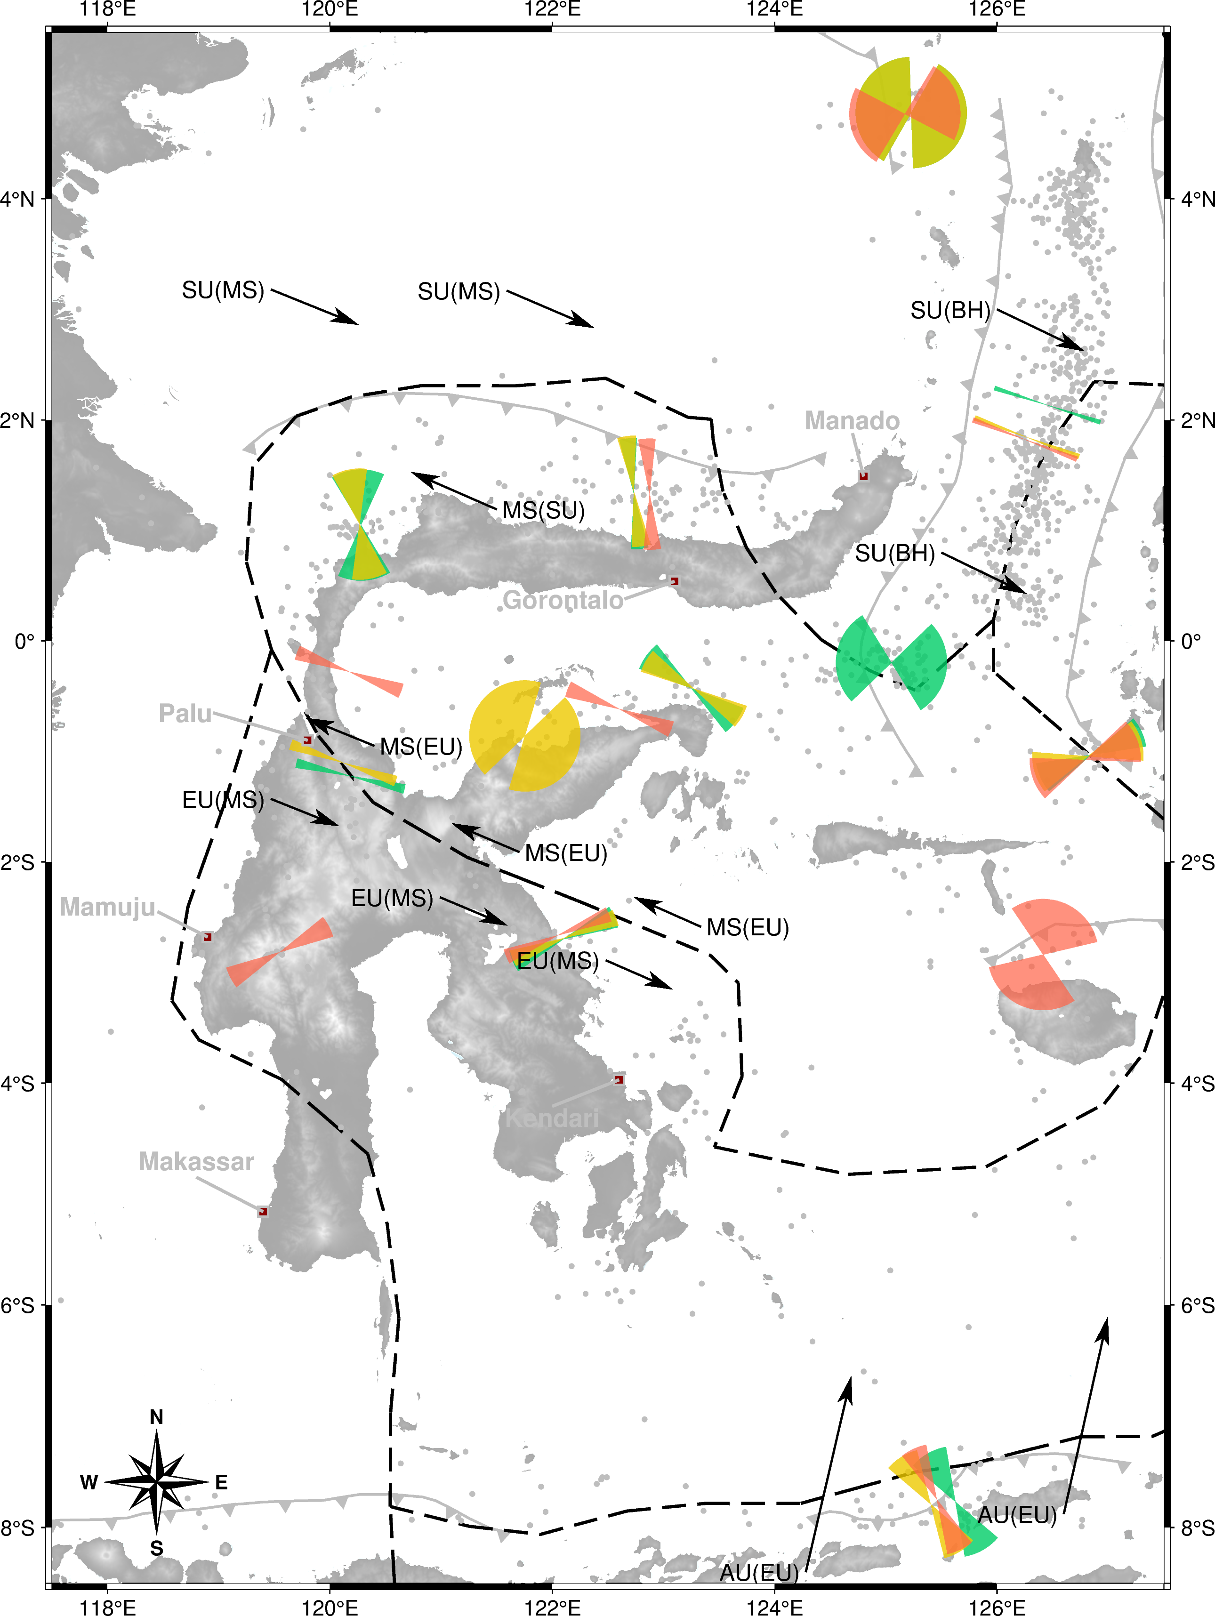
Cluster and SHmax

Slide 4
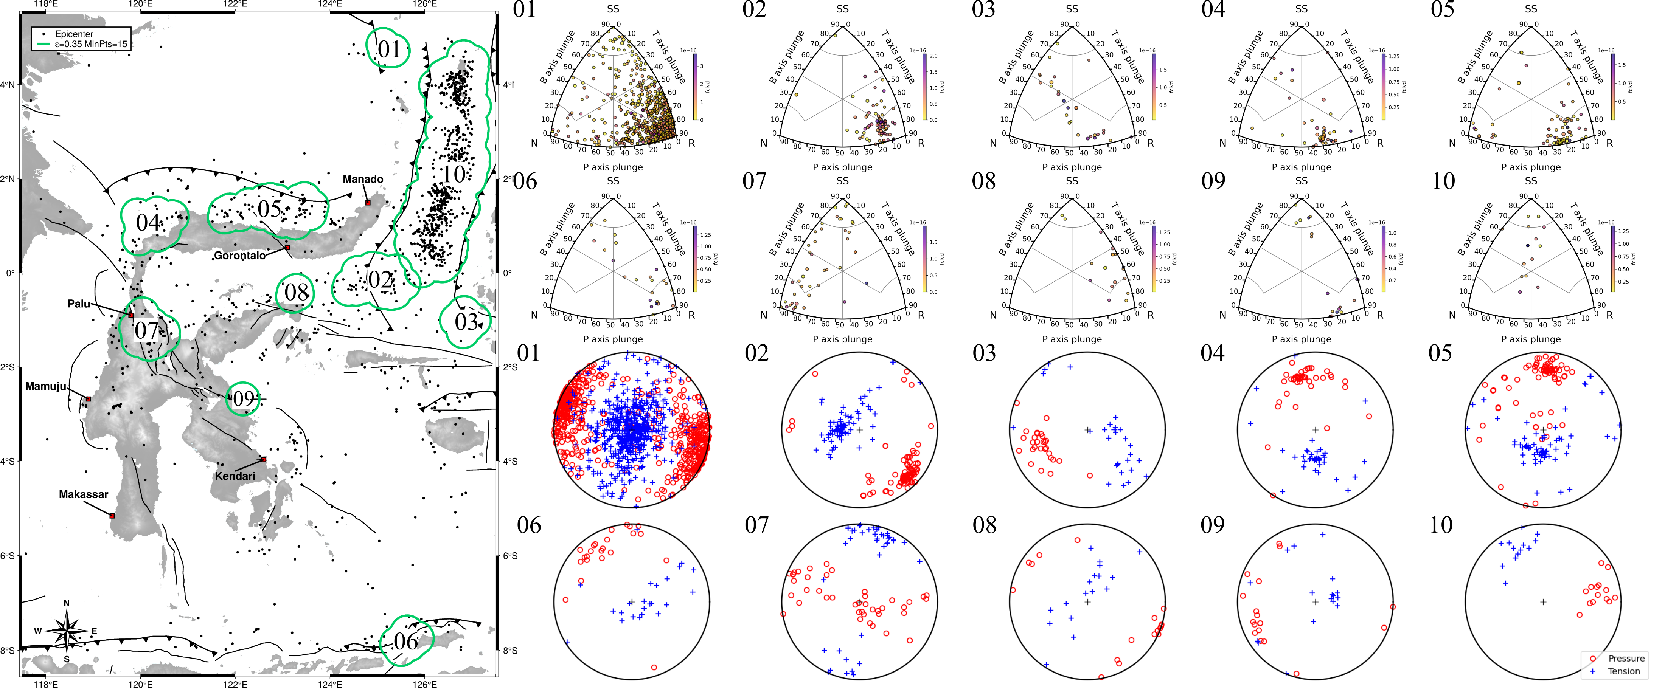
$$Cluster ε0.35 MinPts15$$

Slide 5
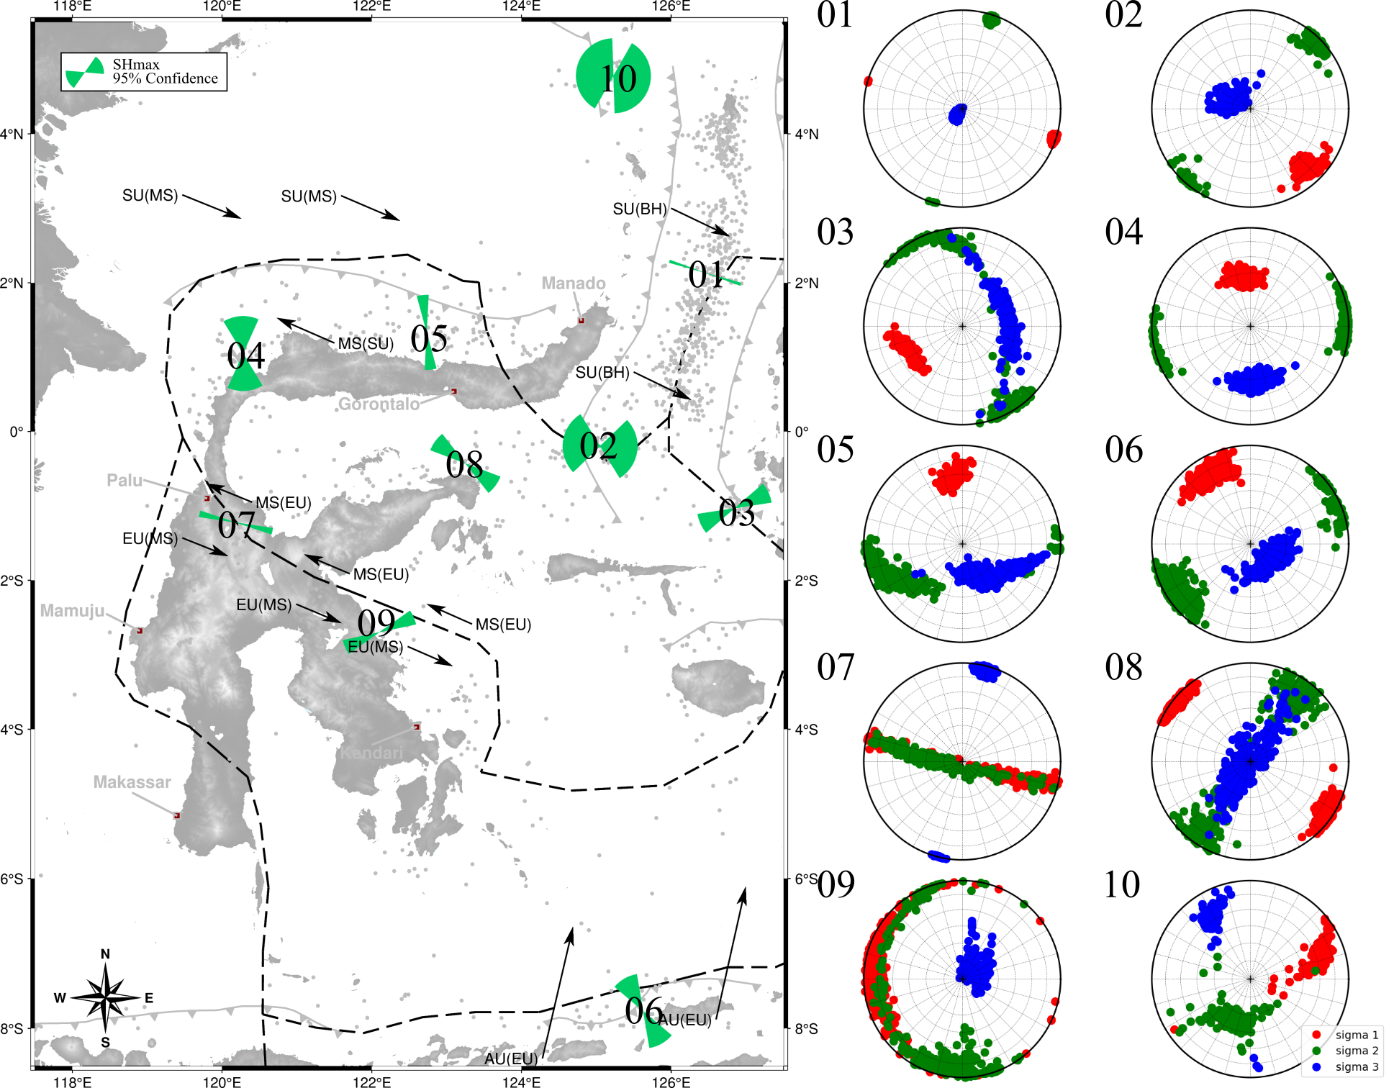
$$Inversion Result Cluster ε0.35 MinPts15$$
Cluster | n_data | SHmax (˚)
01 | 638 | 107.898 ± 2.296
02 | 93 | 97.151 ± 51.200
03 | 28 | 245.188 ± 15.969
04 | 47 | 356.466 ± 27.757
05 | 78 | 353.877 ± 9.055
06 | 23 | 330.309 ± 19.938
07 | 44 | 283.521 ± 4.932
08 | 18 | 306.283 ± 15.552
09 | 18 | 283.848 ± 74.191
10 | 15 | 66.286 ± 11.490

Slide 6
$$Principal Stress Cluster ε0.35 MinPts15$$
Cluster | σ1 |  | σ2 |  | σ3 |  | R
 | Azimuth (˚) | Plunge (˚) | Azimuth (˚) | Plunge (˚) | Azimuth (˚) | Plunge (˚)
01 | 107.826 ± 2.328 | 2.792 ± 2.461 | 17.675 ± 2.371 | 5.336 ± 4.196 | 229.518 ± 28.431 | 83.589 ± 4.383 | 0.809 ± 0.046
02 | 135.294 ± 9.084 | 17.463 ± 9.712 | 44.232 ± 10.158 | 9.224 ± 8.592 | 299.914 ± 37.104 | 70.043 ± 11.310 | 0.603 ± 0.234
03 | 243.597 ± 17.015 | 37.426 ± 6.675 | 346.058 ± 34.909 | 25.253 ± 24.908 | 71.841 ± 65.210 | 38.995 ± 15.978 | 0.852 ± 0.116
04 | 351.478 ± 16.160 | 46.610 ± 8.024 | 82.706 ± 18.536 | 4.966 ± 4.770 | 174.270 ± 21.866 | 43.003 ± 8.181 | 0.705 ± 0.210
05 | 351.511 ± 11.014 | 29.722 ± 11.077 | 244.525 ± 28.055 | 23.316 ± 22.265 | 142.002 ± 42.038 | 46.167 ± 23.645 | 0.795 ± 0.160
06 | 328.667 ± 19.014 | 18.292 ± 11.138 | 238.316 ± 20.326 | 14.818 ± 14.162 | 135.893 ± 55.022 | 65.556 ± 10.688 | 0.672 ± 0.203
07 | 287.859 ± 9.226 | 40.180 ± 37.767 | 106.149 ± 52.299 | 47.373 ± 35.653 | 13.316 ± 4.999 | 4.704 ± 4.548 | 0.177 ± 0.138
08 | 306.461 ± 15.145 | 8.802 ± 8.626 | 215.233 ± 19.139 | 29.042 ± 27.787 | 40.288 ± 69.757 | 59.601 ± 27.169 | 0.744 ± 0.212
09 | 281.891 ± 73.214 | 11.145 ± 10.331 | 192.908 ± 72.950 | 15.862 ± 15.486 | 50.956 ± 54.500 | 69.786 ± 16.418 | 0.442 ± 0.333
10 | 71.987 ± 14.705 | 28.963 ± 21.080 | 193.620 ± 40.641 | 46.540 ± 15.281 | 329.862 ± 10.299 | 24.254 ± 10.852 | 0.550 ± 0.316

Slide 7
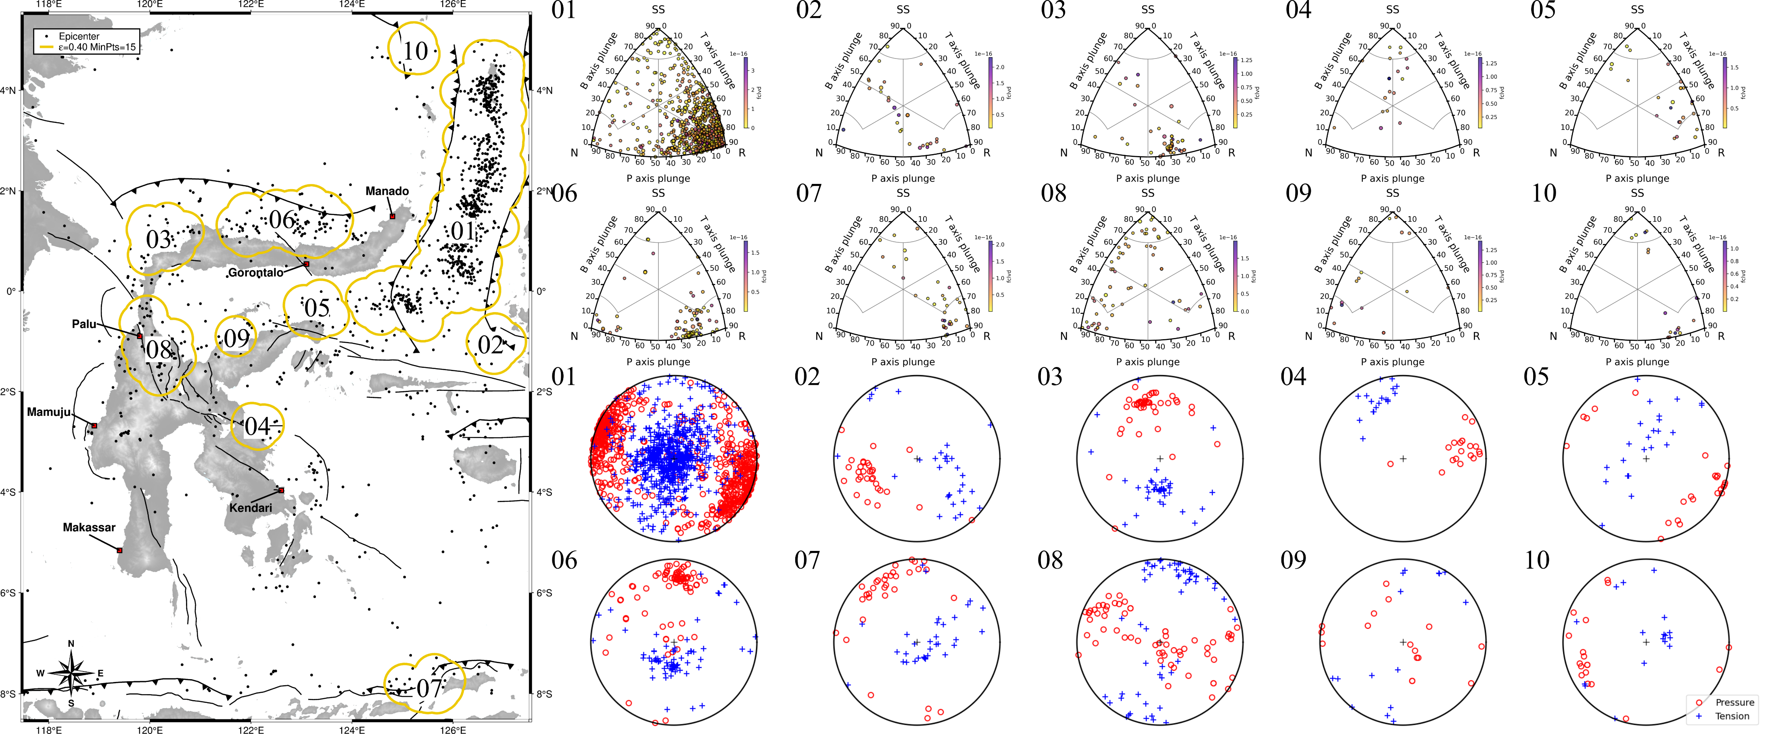
$$Cluster ε0.40 MinPts15$$

Slide 8
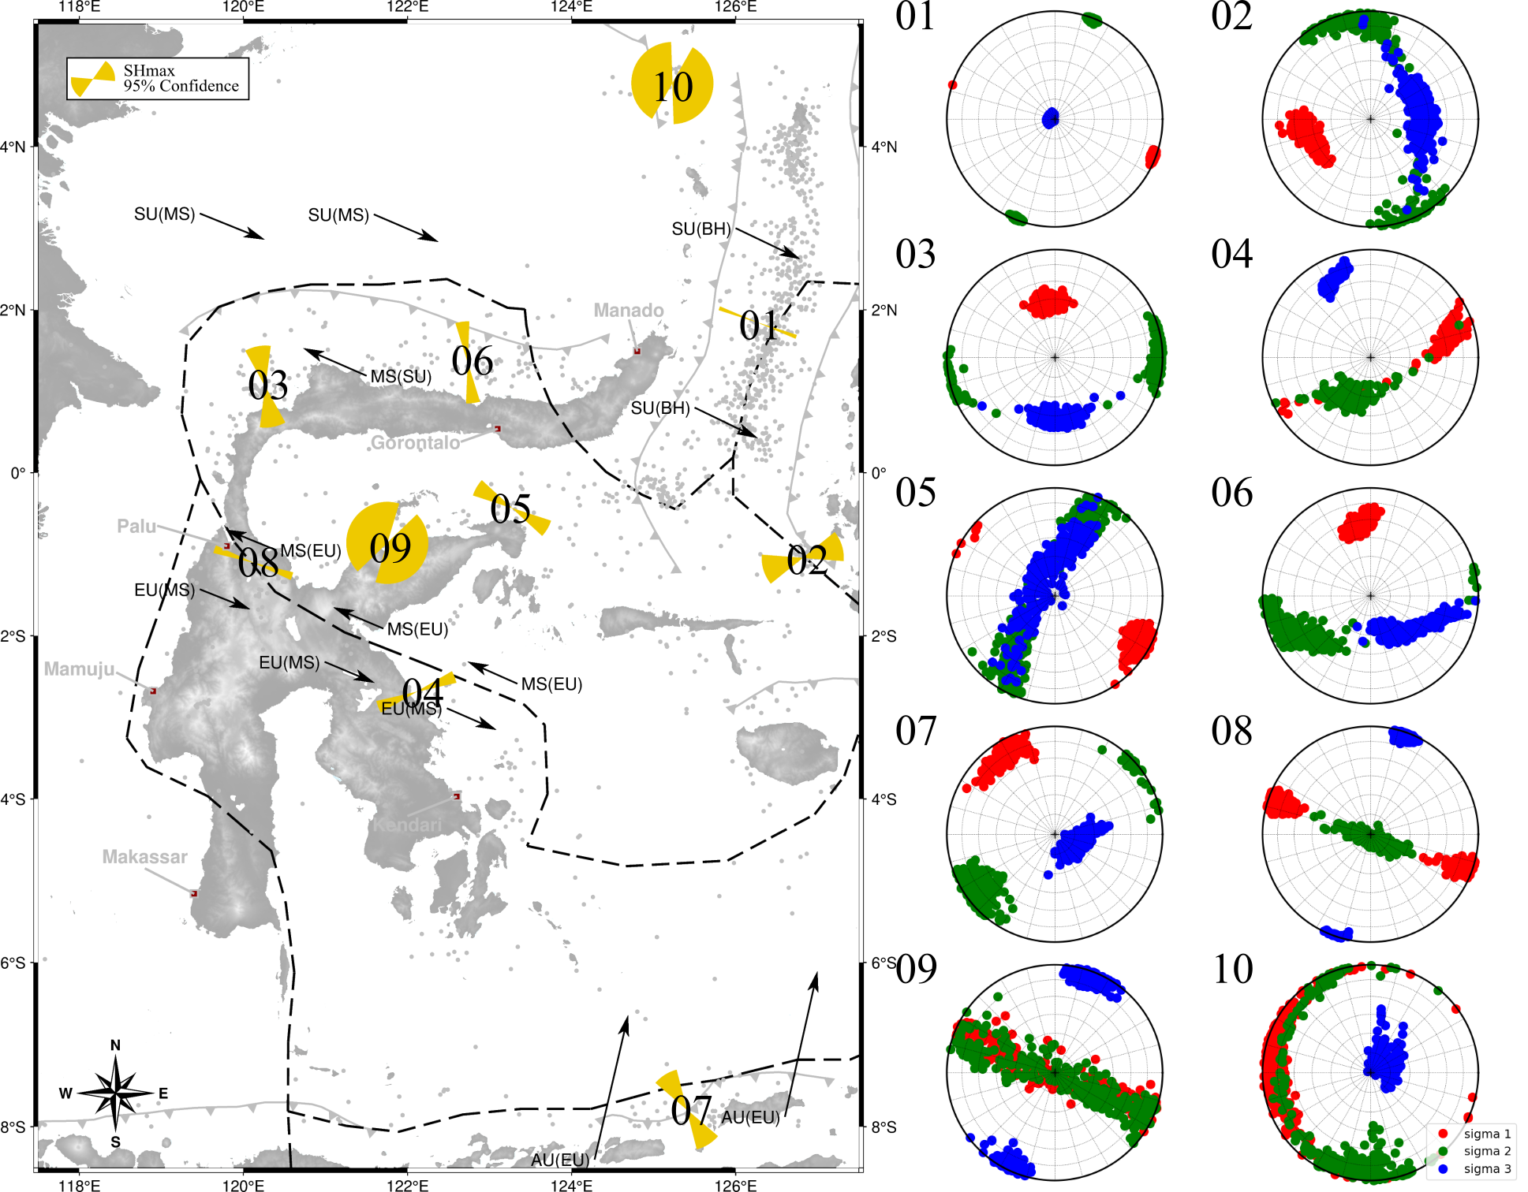
$$Inversion Result Cluster ε0.40 MinPts15$$
Cluster | n_data | SHmax (˚)
01 | 742 | 110.397 ± 2.695
02 | 30 | 252.778 ± 21.611
03 | 49 | 349.244 ± 18.298
04 | 19 | 68.461 ± 8.598
05 | 24 | 120.356 ± 12.321
06 | 81 | 352.450 ± 9.729
07 | 33 | 328.097 ± 17.577
08 | 62 | 289.236 ± 5.506
09 | 16 | 301.363 ± 75.266
10 | 18 | 283.848 ± 74.191

Slide 9
$$Principal Stress Cluster ε0.40 MinPts15$$
Cluster | σ1 |  | σ2 |  | σ3 |  | R
 | Azimuth (˚) | Plunge (˚) | Azimuth (˚) | Plunge (˚) | Azimuth (˚) | Plunge (˚)
01 | 110.425 ± 2.713 | 3.288 ± 2.014 | 200.468 ± 2.735 | 1.894 ± 1.837 | 290.650 ± 50.864 | 86.216 ± 2.050 | 0.759 ± 0.047
02 | 249.241 ± 21.420 | 38.178 ± 10.548 | 347.233 ± 30.347 | 20.118 ± 19.707 | 82.317 ± 58.539 | 44.676 ± 14.591 | 0.857 ± 0.120
03 | 353.257 ± 14.396 | 46.592 ± 7.507 | 264.954 ± 18.529 | 6.568 ± 6.419 | 178.213 ± 22.483 | 42.735 ± 7.092 | 0.745 ± 0.205
04 | 74.076 ± 13.435 | 26.079 ± 17.671 | 203.768 ± 35.673 | 53.040 ± 12.784 | 334.911 ± 8.902 | 21.185 ± 7.206 | 0.423 ± 0.296
05 | 119.739 ± 10.994 | 13.451 ± 11.685 | 206.262 ± 27.652 | 34.872 ± 32.413 | 357.361 ± 74.178 | 49.113 ± 32.909 | 0.731 ± 0.235
06 | 350.084 ± 10.744 | 31.864 ± 9.846 | 241.244 ± 26.140 | 23.272 ± 21.609 | 136.792 ± 36.505 | 43.559 ± 22.467 | 0.826 ± 0.120
07 | 326.190 ± 15.922 | 14.098 ± 8.642 | 232.980 ± 17.228 | 15.472 ± 15.284 | 122.257 ± 43.919 | 66.988 ± 12.950 | 0.618 ± 0.211
08 | 289.145 ± 5.793 | 15.130 ± 14.601 | 121.318 ± 73.411 | 74.117 ± 13.880 | 19.356 ± 5.468 | 4.276 ± 4.012 | 0.308 ± 0.203
09 | 288.830 ± 49.639 | 43.239 ± 40.644 | 123.243 ± 50.336 | 43.806 ± 40.775 | 203.574 ± 14.651 | 8.374 ± 8.006 | 0.365 ± 0.275
10 | 281.891 ± 73.214 | 11.145 ± 10.331 | 192.908 ± 72.950 | 15.862 ± 15.486 | 50.956 ± 54.500 | 69.786 ± 16.418 | 0.442 ± 0.333

Slide 10
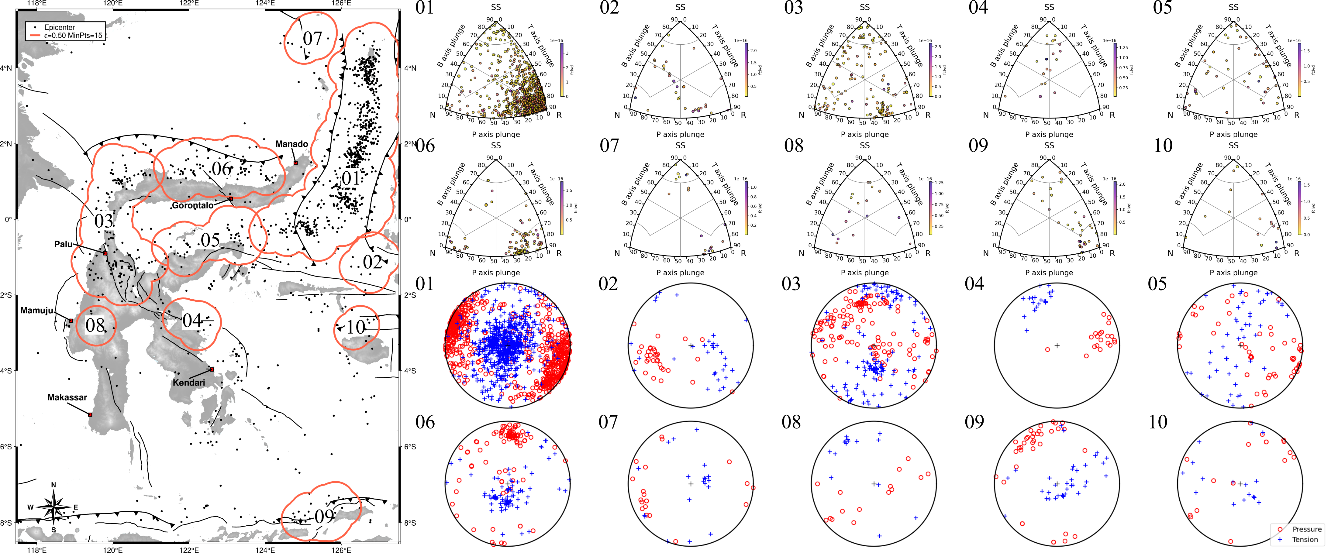
$$Cluster ε0.50 MinPts15$$

Slide 11
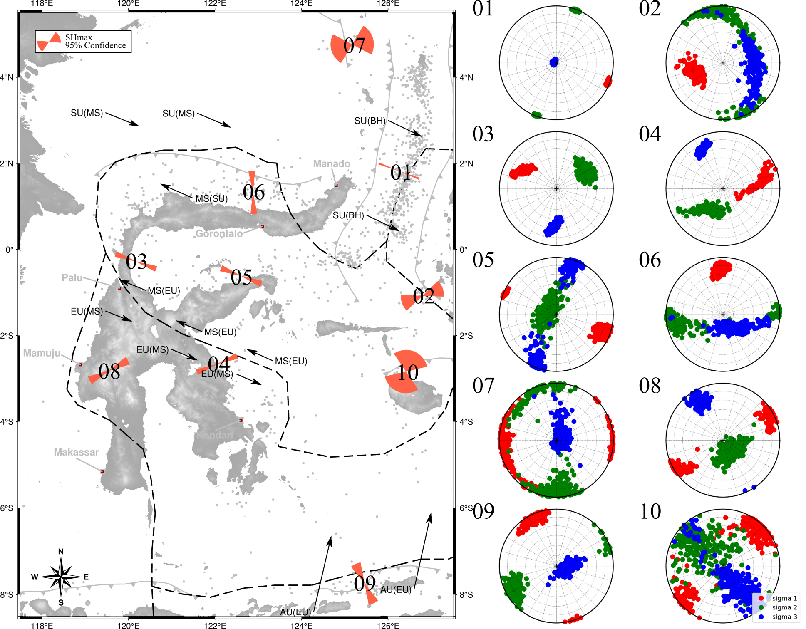
$$Inversion Result Cluster ε0.50 MinPts15$$
Cluster | n_data | SHmax (˚)
01 | 749 | 110.698 ± 2.664
02 | 32 | 249.256 ± 22.699
03 | 146 | 290.195 ± 7.619
04 | 22 | 67.675 ± 7.724
05 | 53 | 111.241 ± 8.300
06 | 96 | 357.147 ± 8.952
07 | 20 | 254.366 ± 43.401
08 | 15 | 242.356 ± 11.399
09 | 37 | 335.192 ± 13.781
10 | 18 | 21.326 ± 55.450

Slide 12
$$Principal Stress Cluster ε0.50 MinPts15$$
Cluster | σ1 |  | σ2 |  | σ3 |  | R
 | Azimuth (˚) | Plunge (˚) | Azimuth (˚) | Plunge (˚) | Azimuth (˚) | Plunge (˚)
01 | 110.692 ± 2.674 | 3.550 ± 2.055 | 20.678 ± 2.704 | 1.995 ± 1.900 | 291.244 ± 51.075 | 86.293 ± 2.005 | 0.765 ± 0.046
02 | 251.351 ± 19.696 | 43.616 ± 12.019 | 0.218 ± 44.149 | 18.250 ± 17.926 | 95.472 ± 55.634 | 34.345 ± 19.796 | 0.854 ± 0.116
03 | 298.828 ± 9.988 | 31.982 ± 10.669 | 58.600 ± 17.807 | 40.623 ± 11.060 | 183.494 ± 7.315 | 32.674 ± 10.402 | 0.617 ± 0.163
04 | 80.794 ± 16.546 | 37.185 ± 21.661 | 211.069 ± 25.322 | 43.883 ± 18.356 | 333.346 ± 8.668 | 22.528 ± 6.794 | 0.451 ± 0.309
05 | 110.722 ± 7.770 | 14.084 ± 12.811 | 282.648 ± 83.643 | 63.791 ± 20.121 | 24.173 ± 14.093 | 22.207 ± 21.780 | 0.788 ± 0.146
06 | 356.122 ± 9.112 | 21.579 ± 11.278 | 254.890 ± 20.085 | 28.720 ± 28.188 | 156.360 ± 58.160 | 50.802 ± 26.790 | 0.786 ± 0.181
07 | 255.678 ± 41.590 | 8.317 ± 8.065 | 165.768 ± 41.275 | 22.792 ± 22.551 | 17.746 ± 81.227 | 66.381 ± 22.359 | 0.526 ± 0.355
08 | 243.227 ± 14.768 | 13.758 ± 13.583 | 146.454 ± 61.897 | 66.937 ± 15.028 | 329.426 ± 10.056 | 18.255 ± 14.688 | 0.433 ± 0.193
09 | 333.373 ± 13.807 | 9.243 ± 8.599 | 241.822 ± 14.972 | 16.461 ± 14.645 | 101.245 ± 48.532 | 69.971 ± 13.077 | 0.649 ± 0.210
10 | 46.804 ± 24.068 | 15.799 ± 15.356 | 305.243 ± 69.119 | 42.303 ± 35.722 | 149.321 ± 38.891 | 41.233 ± 38.155 | 0.621 ± 0.339

Slide 13
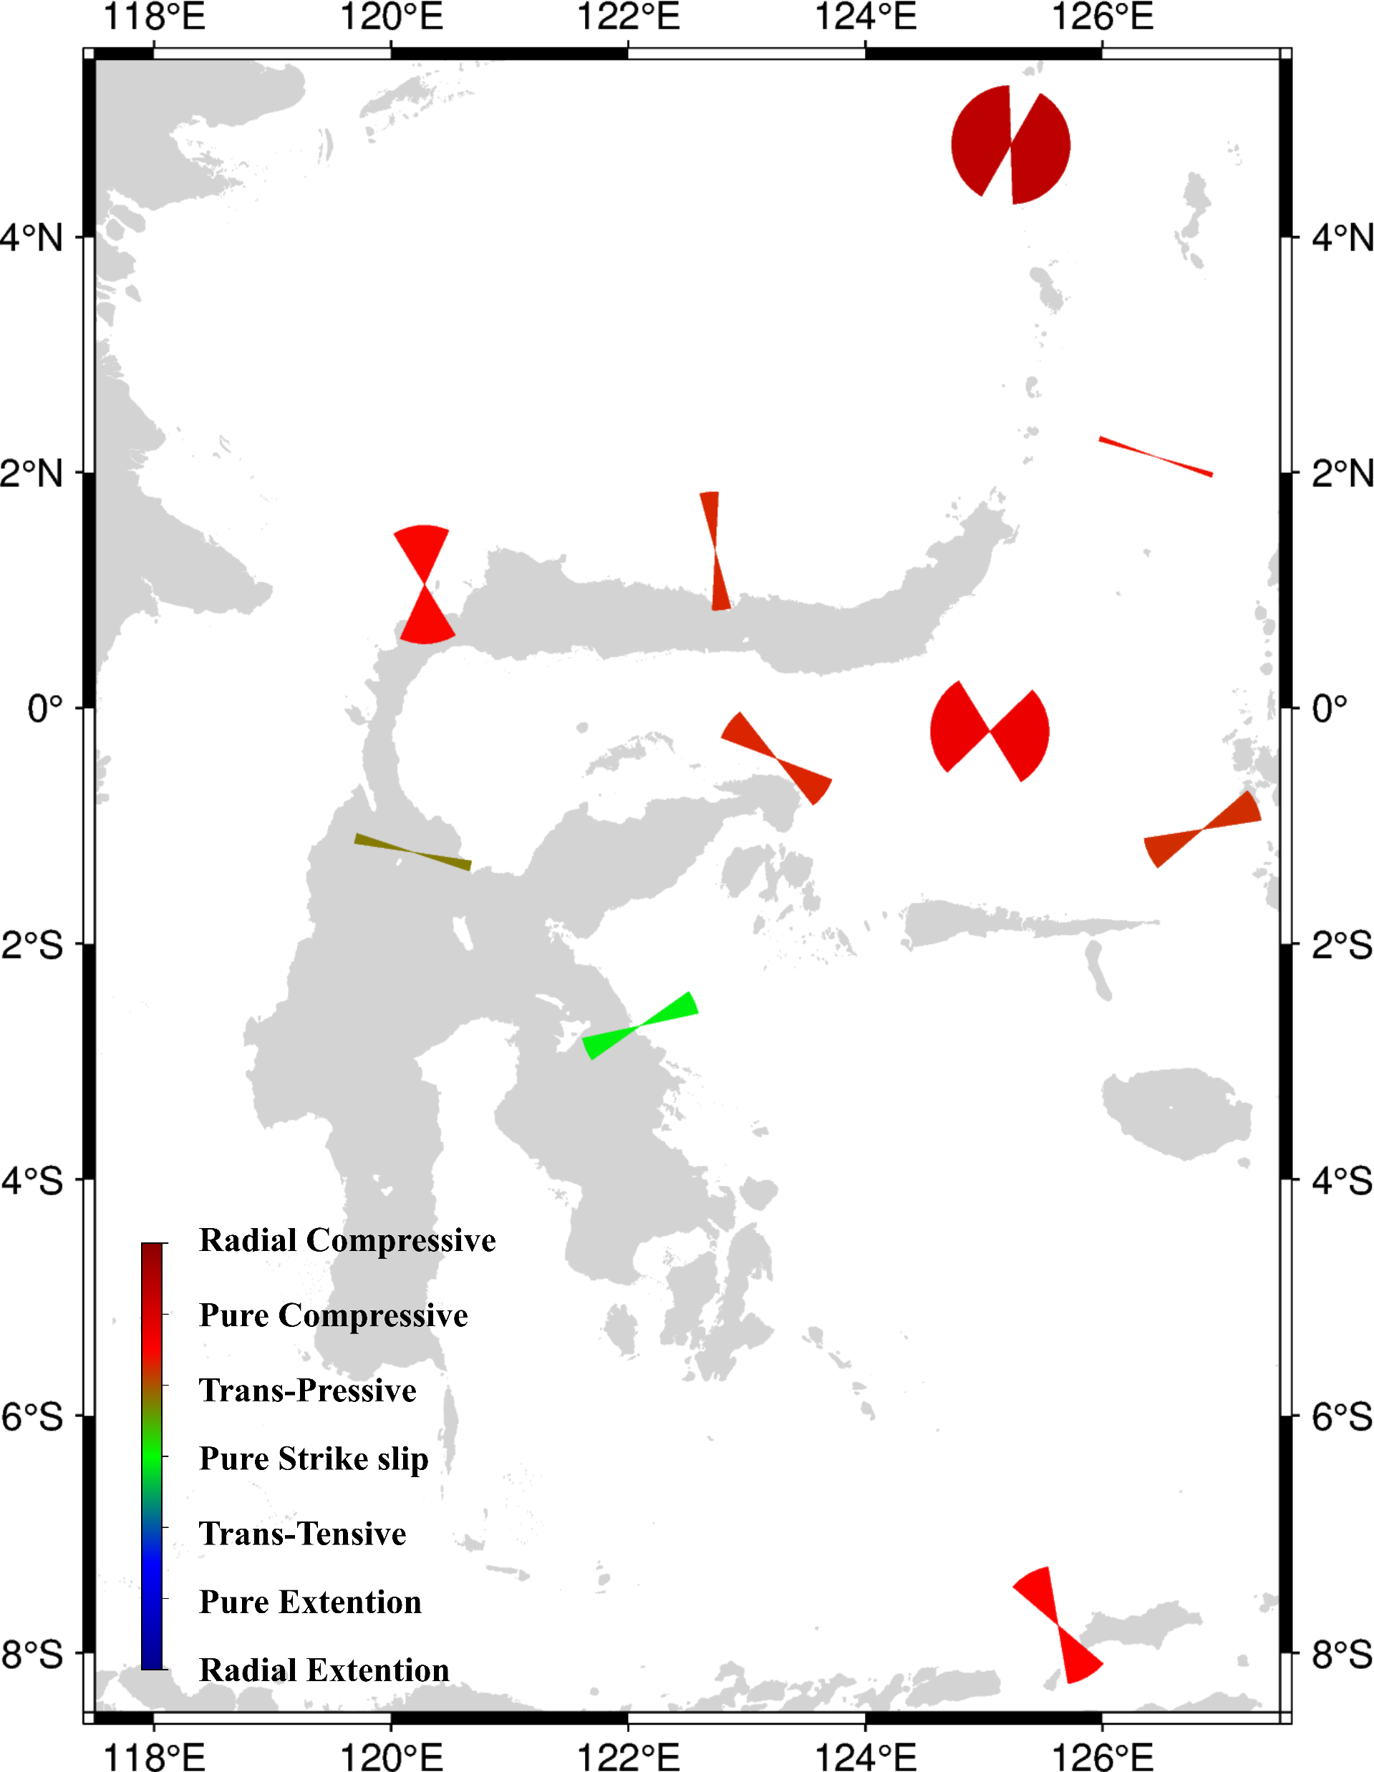
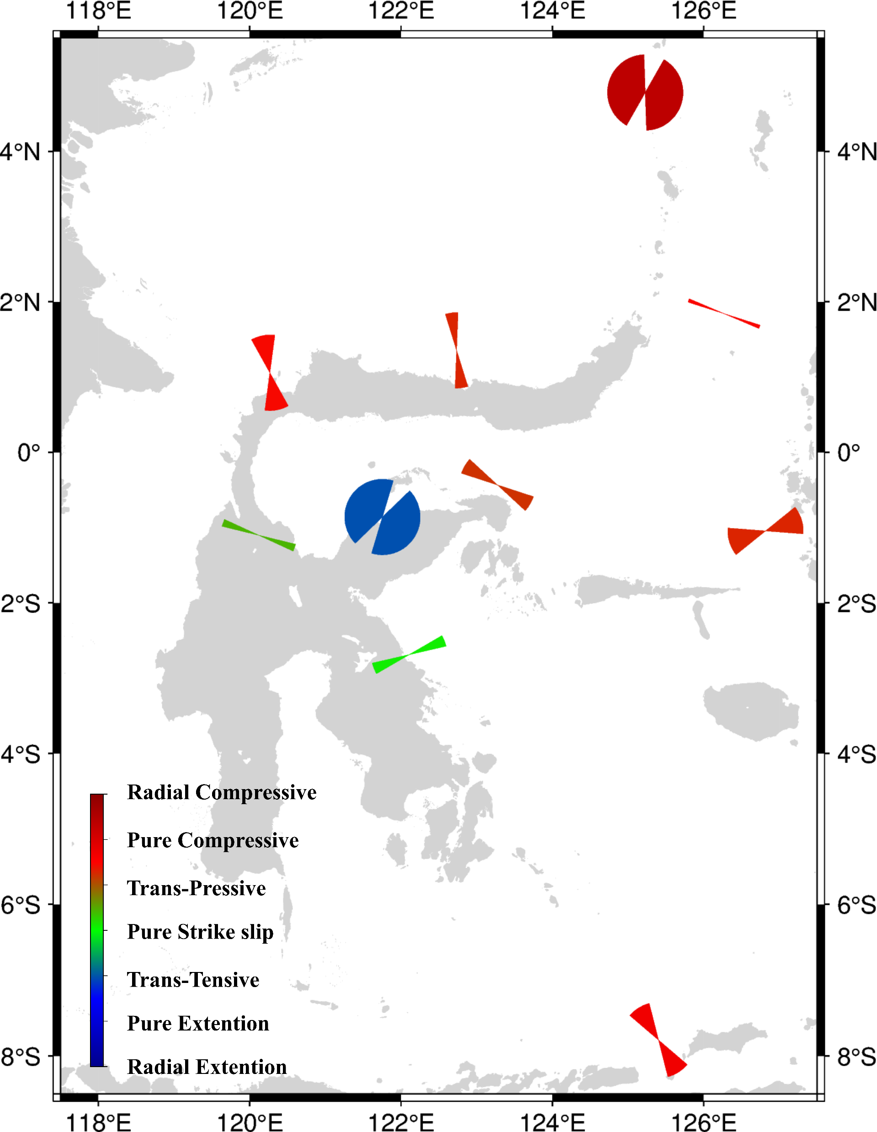
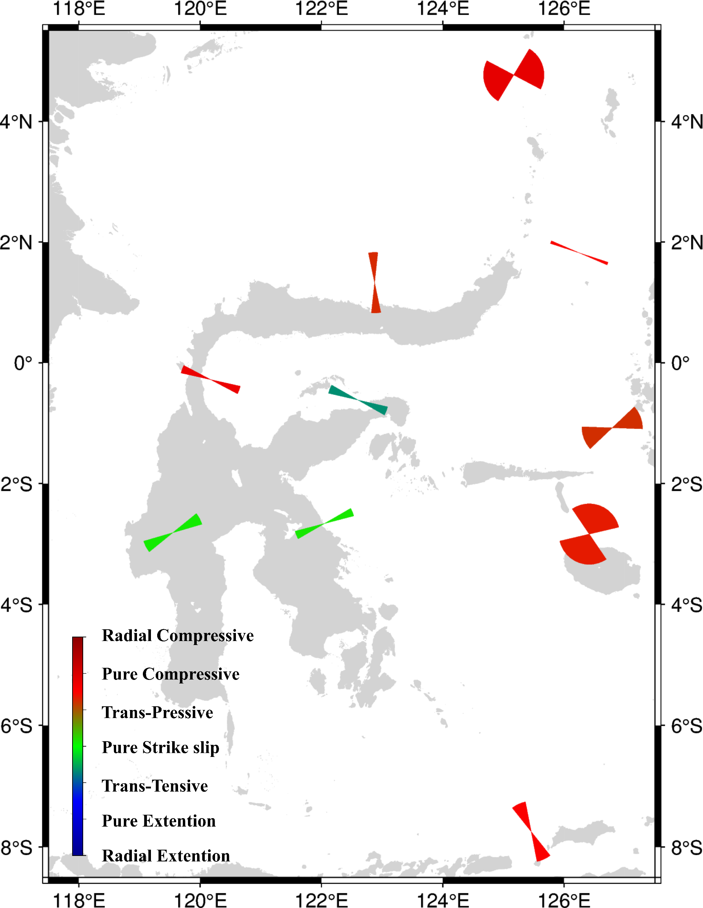
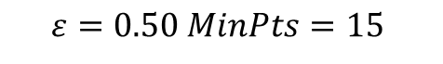
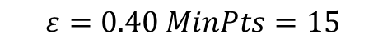
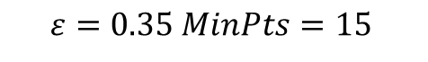
$$Tectonic Regime$$
$$ε=0.35 MinPts=15$$
$$ε=0.40 MinPts=15$$
$$ε=0.50 MinPts=15$$

